Slide 1
Presidency University, Bengaluru
School of Engineering
Computer Science and Engineering
Core Java Revision
&
Environment Setup

Slide 2

Introduction To Java
Flavor's Of Java
JSE
  Java Standard Edition formerly known as J2SE.
  This forms the core part of Java language.
JEE
  Java Enterprise Edition formerly known as J2EE.
  These are the set of packages that are used to develop distributed enterprise-scale applications.
  These applications are deployed on JEE application servers.
JME
  Java Micro Edition formerly known as J2ME.
  These are the set of packages used to develop application for mobile devices and embedded systems.
Notes:
Java also comes in several versions:
JDK 1.0 (1995)
JDK 1.1 (1997)
J2SE 1.2 (1998) ) →Playground
J2SE 1.3 (2000) → Kestrel
J2SE 1.4 (2002) → Merlin
The above 3 was called Java 2
J2SE 5.0 (2004) → Tiger
Java SE 6 ( 2006) → Mustang
Java SE 7 (2011) →Dolphin
Mr. R C Ravindranath, Asst. Prof., SOE-CSE

Slide 3
Contents
Installation and Demonstration to run a program
Fundamentals
Java Programming - Editing, Compiling and Running a ‘Java’ Program
Integrated Development Environments
Basic Input / Output Stream
Practical exercise

Slide 4
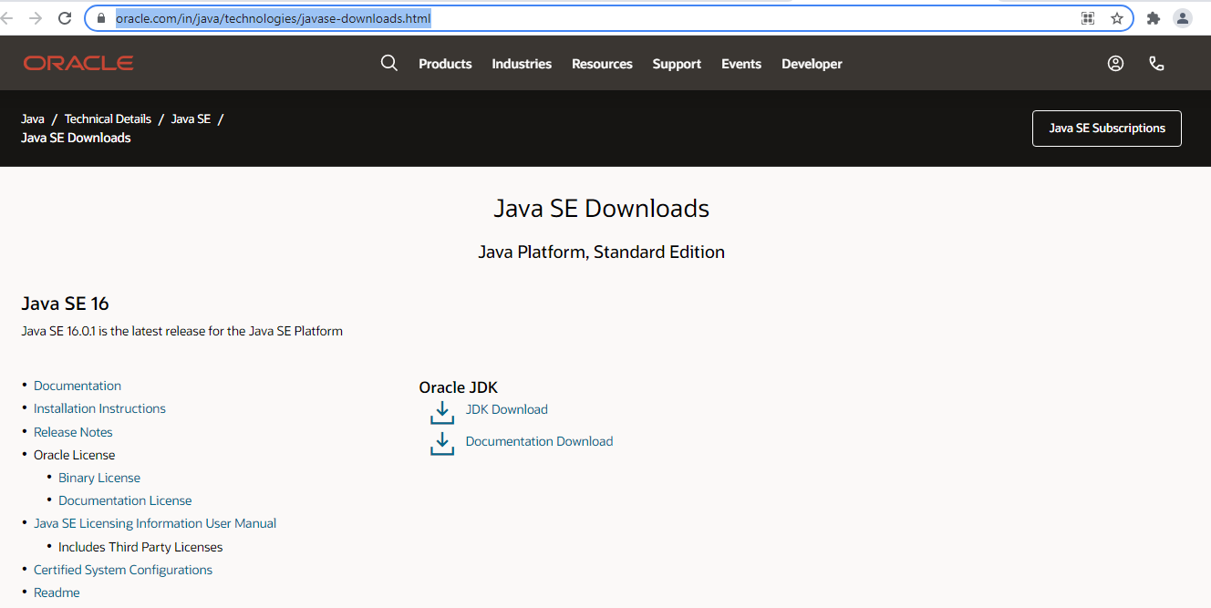
JDK Installation – Java Development Kit
How To Install JDK on Windows
Download JDK@ https://www.oracle.com/in/java/technologies/javase-downloads.html
Install JDK
Click Here

Slide 5
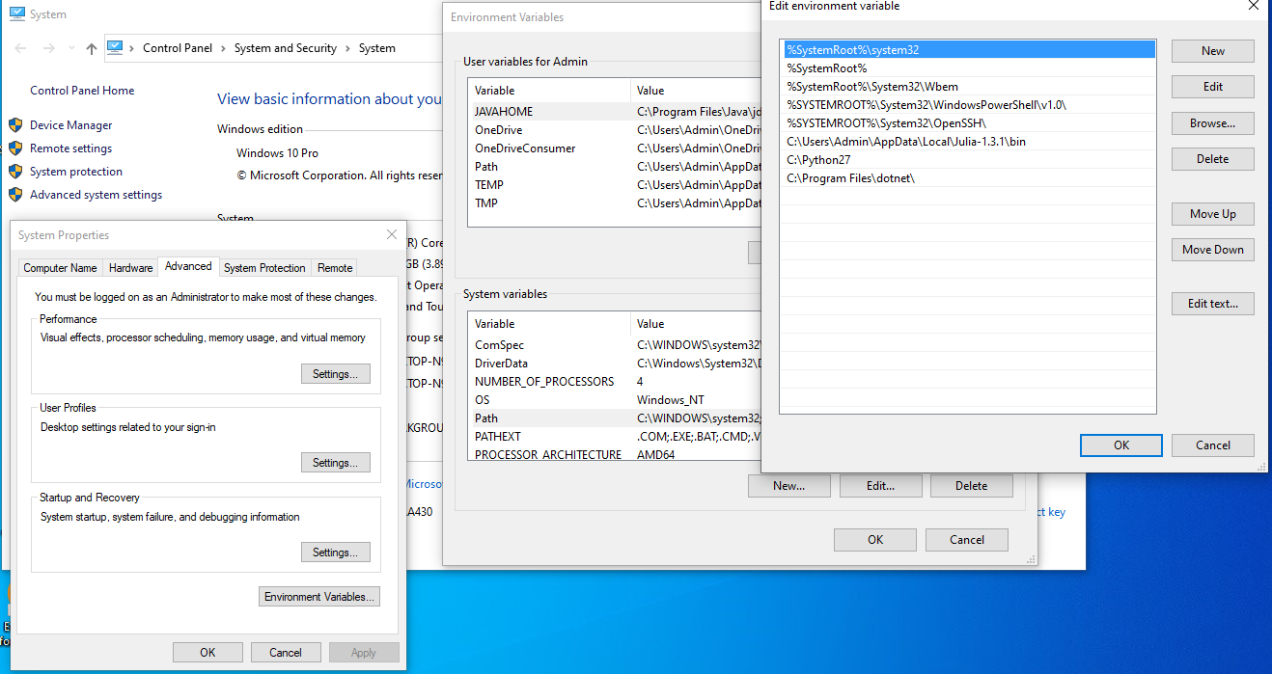
JDK Installation – Java Development Kit
Environment Setup
Include JDK's "bin" Directory in the PATH
Right click mycomputer->Properties
-->Advance Setting
->Click Environment Variable
-> Under System variables
->Select Path and click Edit
->Under Edit menu Click New
->Paste the path of “bin”->ok ->ok
Notes:
Mr. R C Ravindranath, Asst. Prof., SOE-CSE

Slide 6
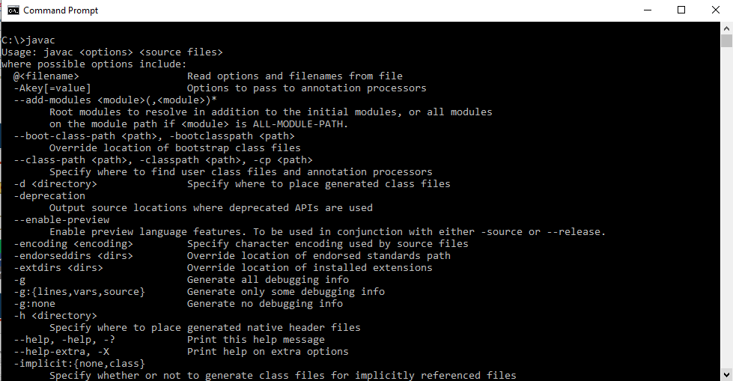
JDK Installation - Confirmation

Slide 7

After JDK Installation
JVM, JRE & JDK – After Installation
JVM
  stands for Java Virtual Machine which provides the runtime environment for Java bytecodes to be executed.
JRE (Java Runtime Environment)
  includes the sets of files required by JVM during runtime.
JDK (Java Development Kit)
  consists of JRE along with the development tools required to write and execute a program.

Slide 8













After JDK Installation
JVM, JRE & JDK – After Installation
SOURCE CODE
Compiler
BYTE CODE
OUTPUT
Interpreter
JVM
JVM + JRE
MACHINE
OPERATING SYSTEM
Interpreter
Memory Management
HARDWARE
JIT/Compiler
MACHINE CODE

Slide 9




After JDK Installation
JVM, JRE & JDK – After Installation
To execute Java program, JRE must be installed in the system
JRE or Java Runtime environment contains
  Java Virtual Machine
  Standard class libraries (APIs)
  Java Plug-in
  Java Webstart
JRE gets installed automatically when JDK is installed. JRE can be installed independent of JDK as well. This will mean that Java programs can be executed in that system.
SOURCE CODE
(filename.java)
Compile
BYTE CODE
(filename.class)
Interpreter
JVM
Machine Code
MACHINE
Platform Independent
Platform Dependent

Slide 10





Fundamentals
Java Program Structure

Slide 11

Fundamentals
Editing, Compiling and Running a ‘Java’ Program
Java Programming
Step |  | What is done |  | Command | Comments
1 |  | Editing |  | C:>notepad HelloWorld.java
class HelloWorld { //Note: class name is same as the filename public static void main(String[] args) { System.out.println("Hello, World"); } }
2 | Compiling |  | C:> javac HelloWorld.java |  | The class file “HelloWorld.class” is generated
3 | Executing |  | C:> java HelloWorld |  | Output: Hello World
Notes:
Mr. R C Ravindranath, Asst. Prof., SOE-CSE

Slide 12

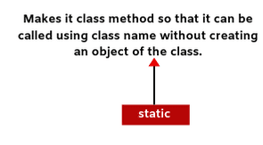
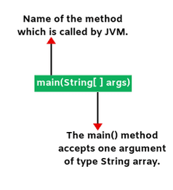
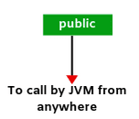
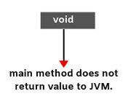
Java Programming
public static void main(String[] args)

Slide 13

Integrated Development Environments
Demonstration of Sample program in Eclipse
There are many programs that support the development of Java software, including:
  - Sun Java Development Kit (JDK) - Borland JBuilder
  - Sun NetBeans - MetroWerks CodeWarrior
  - IBM Eclipse - BlueJ
  - jGRASP
Though the details of these environments differ, the basic compilation and execution process is essentially the same.

Slide 14

Integrated Development Environments
Eclipse Environment Setup
Download Recent version of Eclipse from the following link.
https://www.eclipse.org/downloads/download.php?file=/oomph/epp/2022-12/R/eclipse-inst-jre-win64.exe&mirror_id=1273
Install Jdk 1.8
Install Eclipse

Slide 15




























Control Statements : Tasks to students
Control Flow Statements
Decision Making Statements
Looping Statements
Branching Statements
if - then
for
break
for - each
if – then - else
continue
while
switch - case
do - while
return

Slide 16
Overview
Class and Object
Abstract class & Interface
Array and String
Inheritance
Exception Handling

Slide 17
Class and Object
public class Circle {
public double x, y; // centre of the circle
public double r; // radius of circle
//Methods to return circumference and area
public double circumference() {
return 2*3.14*r;
}
public double area() {
return 3.14 * r * r;
}
}
public class Test {
public static void main(String args[]) {
Circle aCircle = new Circle();
Circle bCircle = new Circle() ;
aCircle.circumference();
a.area();
bCircle.circumference();
b.area();
}
}
Questions to Students

Slide 18
Abstract Class
abstract class Shape{
abstract void draw();
}
class Rectangle extends Shape{
void draw(){
System.out.println("drawing rectangle");}
}
class Circle1 extends Shape{
void draw(){System.out.println("drawing circle");}
}
class TestAbstraction1{
public static void main(String args[]){
Shape s=new Circle1();
s.draw();
}
}
Questions to Students
An abstract class is a class that is declared abstract —it may or may not include abstract methods.
Abstract classes cannot be instantiated, but they can be subclassed.
When an abstract class is subclassed, the subclass usually provides implementations for all of the abstract methods in its parent class.
//In real scenario, implementation is provided by others i.e. unknown by end user
//In real scenario, method is called by programmer or user
//In a real scenario, object is provided through method, e.g., getShape() method

Slide 19
Interface
interface printable{
void print();
}
class A implements printable{
public void print(){
System.out.println("Hello");
}
public static void main(String args[]){
A obj = new A6();
obj.print();
}
}
Questions to Students
The interface in Java is a mechanism to achieve abstraction. There can be only abstract methods in the Java interface, not method body. It is used to achieve abstraction and multiple inheritance in Java.
interfaces can have abstract methods and variables. It cannot have a method body.

Slide 20
Array
Questions to Students
new int[10];
double array = new double[5];
int[][] Intarray = new int[3][3];

Slide 21
String Classes and Methods
String Class Methods
hashCode()
getChars()
equals()
equalIgnoreCase()
length()
replace()
splits()
toCharArray()
substring()
trim()
Questions to Students
String (Immutable)
StringBuffer (Mutable & Synchronized)
StringBuilder (Mutable & Non-Synchronized)

Slide 22
String Classes and Methods
StringBuilderClass Methods
insert()
append()
replace()
delete()
reverse()
capacity()
charAt()
ensureCapacity()
substring()
length()
Questions to Students
StringBuffer Class Methods
insert()
append()
replace()
delete()
reverse()
capacity()
charAt()
ensureCapacity()
substring()

Slide 23
Exception Handling
Questions to Students
For Runtime Error Handling
try, catch as handler
throw as manually exception creator
throws for checked Exception avoidance for compiler burden
finally as executor of statements skipped

Slide 24
Advanced Java Course Contents:
0
Multithreading
I/O and File Operation using Java
Database operation (CRUD) using Java
Web application development using Java servlet and Java Server Page (JSP)
Spring Framework and Spring Modules

Slide 25
Summary on Java
0
After examining scope, usage and potential of different areas of Java Technology we can summarize that it has still long way to go.
Java has got a lot of potential to develop and grow in many areas.
For existing areas like desktop applications and enterprise applications there are chances for Java to gain better role.
Also it has got to grow in new areas of embedded applications in future.

